Slide 1

JSS ACADEMY OF TECHNICAL EDUCATION BANGALORE
DEPARTMENT OF ELECTRONICS AND COMMUNICATION ENGINEERING

Slide 2
Project group
Girish E. (1JS10EC031)
Pramod S. (1JS10EC066)
Prashant Aithal (1JS10EC067)
Rajath B.R. (1JS10EC071)
PROJECT BATCH NUMBER : B2
PROJECT GUIDE :
Mrs. H.S. Kavitha
Asst. Professor
Dept. of Electronics and Communication Engineering
JSS Academy of Technical Education

Slide 3
Project title
Web Based Monitoring of Soil Parameters Using Constrained Application Protocol(CoAP)

Slide 4
Main idea or goal watever
Objective
To collect soil parameters, which is one of the most fundamental data required for precision agriculture by Wireless Sensor Networking using Web browser.
In this context, measurement of the following soil parameters will be done:
Electrical Conductivity
Volumetric Water Content
Soil Temperature

Slide 5
The software side
2) Software: Contiki 2.7 embedded OS release is used with TelosB motes in the project. Contiki is an open source, highly portable, multi-tasking operating system for the resource constrained wireless sensor networks. The 6LoWPAN µIPv6 stack in Contiki provides highly memory efficient implementation of IP, UDP, TCP and ICMP protocols. The Contiki OS kernel is event driven and it is completely written in C programming language, and supports dynamic runtime linking of application programs.In Contiki 2.7, platforms with the TI MSP430 can be emulated.

Slide 6
Constrained Application Protocol (CoAP) is an application layer protocol that is intended for use in resource-constrained internet devices, such as WSN nodes. CoAP is designed to easily translate to HTTP for simplified integration with the web, while also meeting specialized requirements such as multicast support, very low overhead, and simplicity.
Contiki Erbium CoAP implementation that is bundled with Contiki 2.7 is used in the development. The Erbium REST engine includes framework for developing both CoAP server and CoAP client applications. The release also includes a Mozilla Firefox browser plugin Copper (Cu), CoAP user agent implementation for monitoring resources using Web browser.

Slide 7
The hardware side
) Hardware -A sensor node, also known as mote, is a node in a wireless sensor network (WSN) that is capable of performing some processing, gathering sensory information and communicating with other connected nodes in the network.
The TelosB mote is used which consists of Texas Instruments MSP430 Microcontroller along with 250kbits/s 2.4 GHz IEEE 802.15.4 Chipcon Wireless Transceiver. It has 10kB RAM along with 48kB flash.

Slide 8
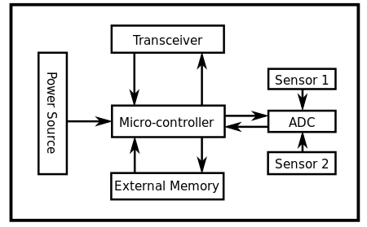

Slide 9
The 5TE soil sensor from Decagon device is used as a sensor. This soil sensor is interfaced to work with TelosB for the application demonstration. 5TE is an integrated sensor that can measure 3 different soil parameters - electrical conductivity (EC), soil temperature and volumetric water content. Like all ECH2O sensors, 5TE determines volumetric water content by measuring the dielectric constant of the media using capacitance/frequency domain technology. The sensor uses a 70 MHz frequency, which minimizes salinity and textural effects, making the 5TE accurate in most soils. The 5TE measures temperature with an on-board thermistor, and electrical conductivity using a stainless steel electrode array. The sensor connects through a 3 wire cable with a stereo connector or bare wire interface. The three connections are Excitation, Ground and Serial Out (data).The excitation is from 3.6 to 15 volts. Current drain during the water content measurement (approx. 10ms duration) can be as high as 45mA. The sensor outputs data at 1200 baud rate in asynchronous mode with 8 data bits, 1 stop bit and no parity bit. The output from the sensor is in the form of raw data in Tera Term Language(TTL) format as given below:
56 432 645<0D>zG<0D><0A>
The raw data requires to be converted with suitable formula to arrive at the actual soil parameters.

Slide 10
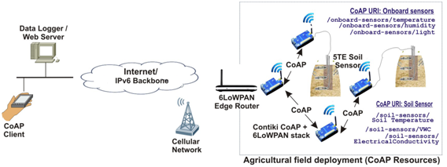
In practical implementation

Slide 11
The above figure shows the monitoring of remote agricultural sensor resources using CoAP. The architecture has two network segments, namely Agricultural field network and Monitoring Network. Field network consist of motes that are interfaced to soil sensors. The motes run CoAP server managing the monitorable CoAP resources. The soil sensor resources and onboard sensor resources can be discovered and CoAP methods can be acted on them using the identified CoAP URI. The CoAP application network will be connected to the IPv6 backbone/internet using the CoAP Proxy/border router. The CoAP proxy is the gateway for the field network to connect internet using cellular network.
Monitoring network consists of CoAP client node(s) and web server. CoAP clients can be utilized for real-time access to sensor data, while web server can give access archived data to the farmer and the agricultural scientist.

Slide 12
Thank You!

